Slide 1

Crime RATE ANALYSIS
M.Shanmukha mani (VTU20467),
L.Pavan Kumar Reddy(VTU20456),
V.Sai Kumar Reddy(VTU20911)
Presented By,
Batch - 05

Slide 2

Introduction
Crime rate analysis is a methodology approach used to identify crime spots and it is not an easy approach.
Understanding crime rates is crucial for public safety and policy-making. Analyzing trends can provide insights into underlying causes and potential solutions.

Slide 3
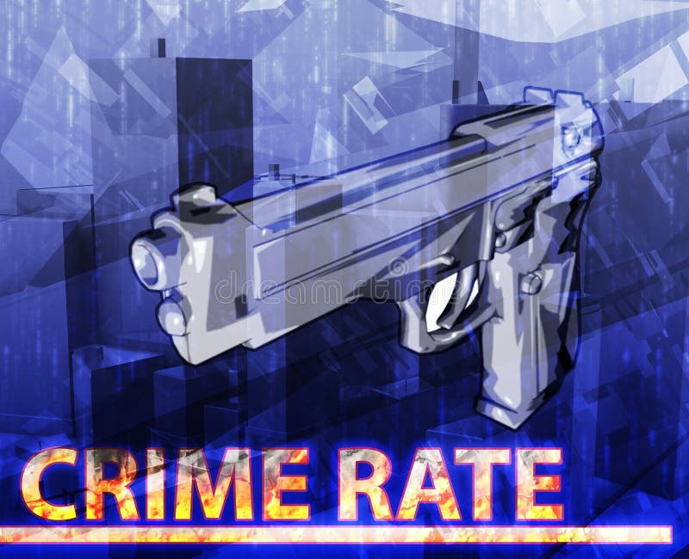
Abstract
Crime rates are a critical indicator of societal well-being and safety, influencing public policies, resource allocation, and community dynamics. This study presents a comprehensive analysis of crime rates, focusing on understanding the multifaceted factors influencing crime occurrences and the trends over time. Utilizing diverse datasets and advanced analytical techniques, this research delves into the complex interplay of socio-economic, demographic, environmental, and policy-related variables affecting crime rates.
Moreover, the analysis explores the impact of technological advancements, including surveillance systems and predictive policing algorithms, on crime prevention and detection.

Slide 4

Factors influencing crime rates
Socio-economic conditions
Demographic factors
Social disorganization
Urbanization and population density
Availability of firearms and weapons.
Substance abuse and addiction
Cultural and societal norms
Law enforcement and criminal justice policies

Slide 5

OBJECTIVES
Identify trends
Understand contributing factors
Assess spatial patterns
Evaluate interventions
Predict future trends
Inform policy development
Inform policy development
Promote transparency and accountability

Slide 6
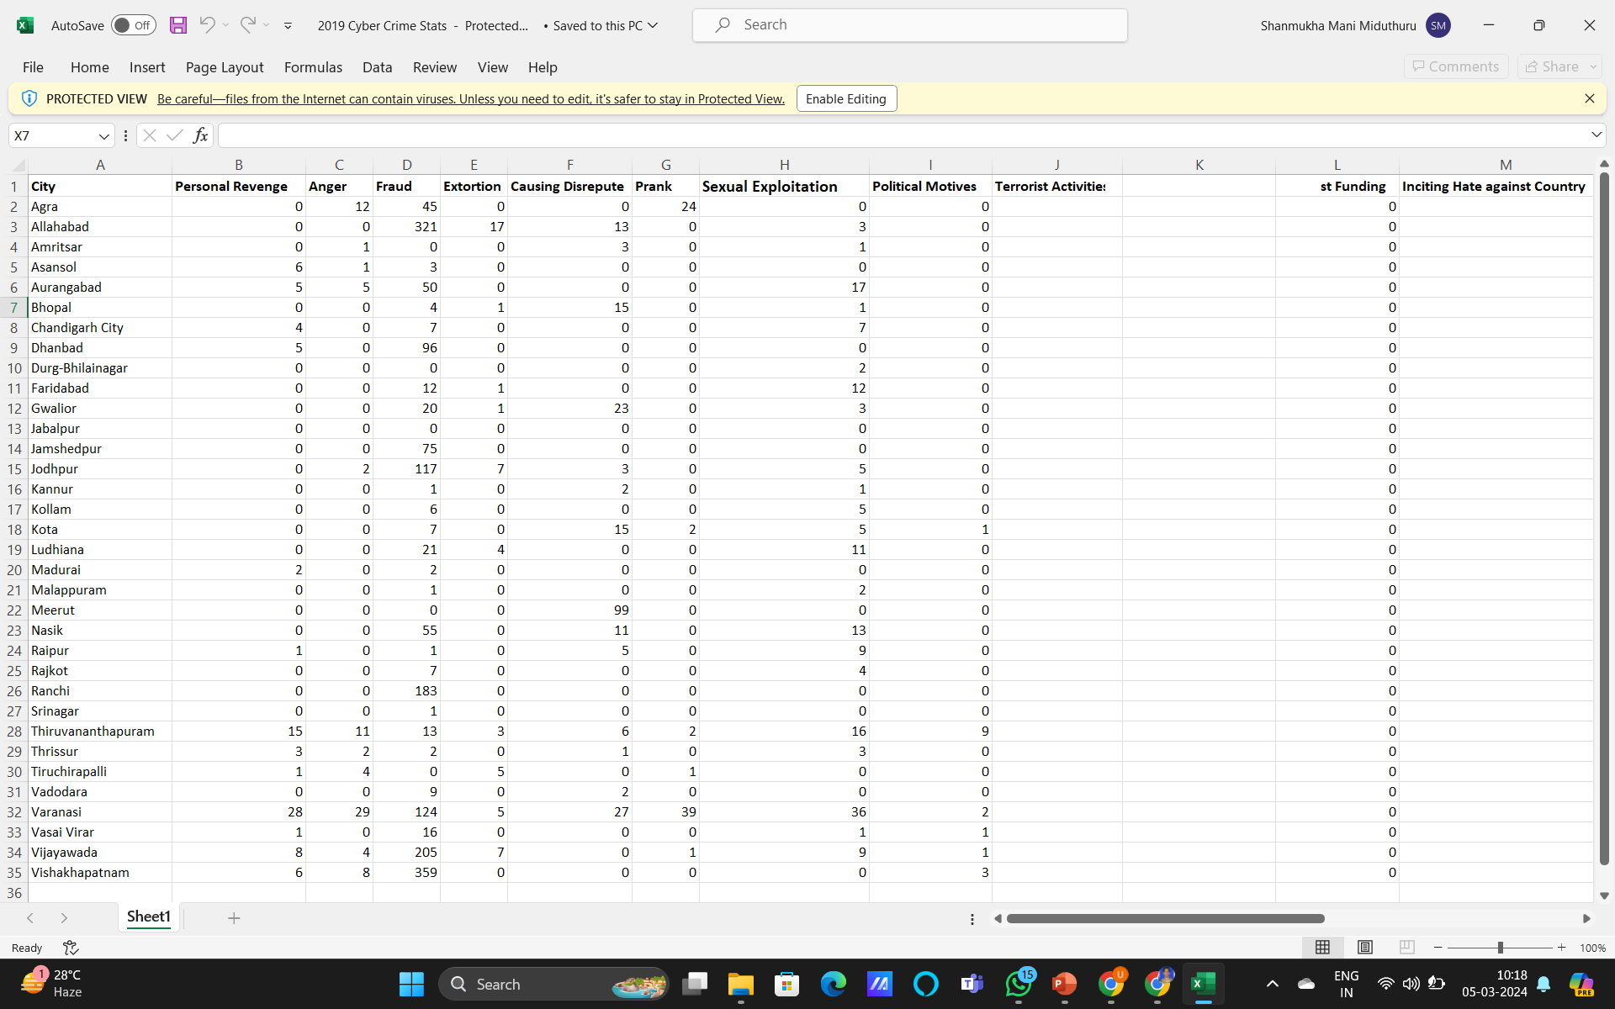
Data Set for crime rate analysis
We are Creating a Data Set Based on the Crime rates in india from 2023-2024 from references using news papers. State wise partition is done.

Slide 7
COnclusion
The analysis of crime rates is a multifaceted endeavor that requires a comprehensive understanding of the complex interplay of socio-economic, demographic, environmental, and policy-related factors influencing crime occurrences. Through this study, we have examined historical trends, identified contributing factors, assessed spatial patterns, evaluated interventions, predicted future trends, and provided recommendations for policy development and data improvement.
The analysis of crime rates is an ongoing process that requires collaboration across disciplines and sectors. By working together to address underlying social, economic, and environmental factors, we can create safer and more equitable communities for all individuals

Slide 8
Thank You

